Slide 1
Meteorite Landings
Lane Mikkelsen, Matteo Alemany, AJ Tennathur

Slide 2
Background Information
Data is collected by Javier de la Torre of The Meteoritical Society and published by NASA Public Data.
The goal of the study was to create a comprehensive list of all known meteorite landings on Earth.
Meteorites are fragments of interplanetary material that enter Earth’s Atmosphere, heating up due to friction and creating glowing trails.

Slide 3
Data and Methodology
The data was gathered via an observational study
The observational units are individual meteorites.
The sampling scheme is a census in order to make the dataset comprehensive.
The sample size is 45,716. We have filtered the data to remove inaccuracies and make our visualizations more comprehensible.
Due to the nature of the study, there are no response variables, covariates, or controls.

Slide 4
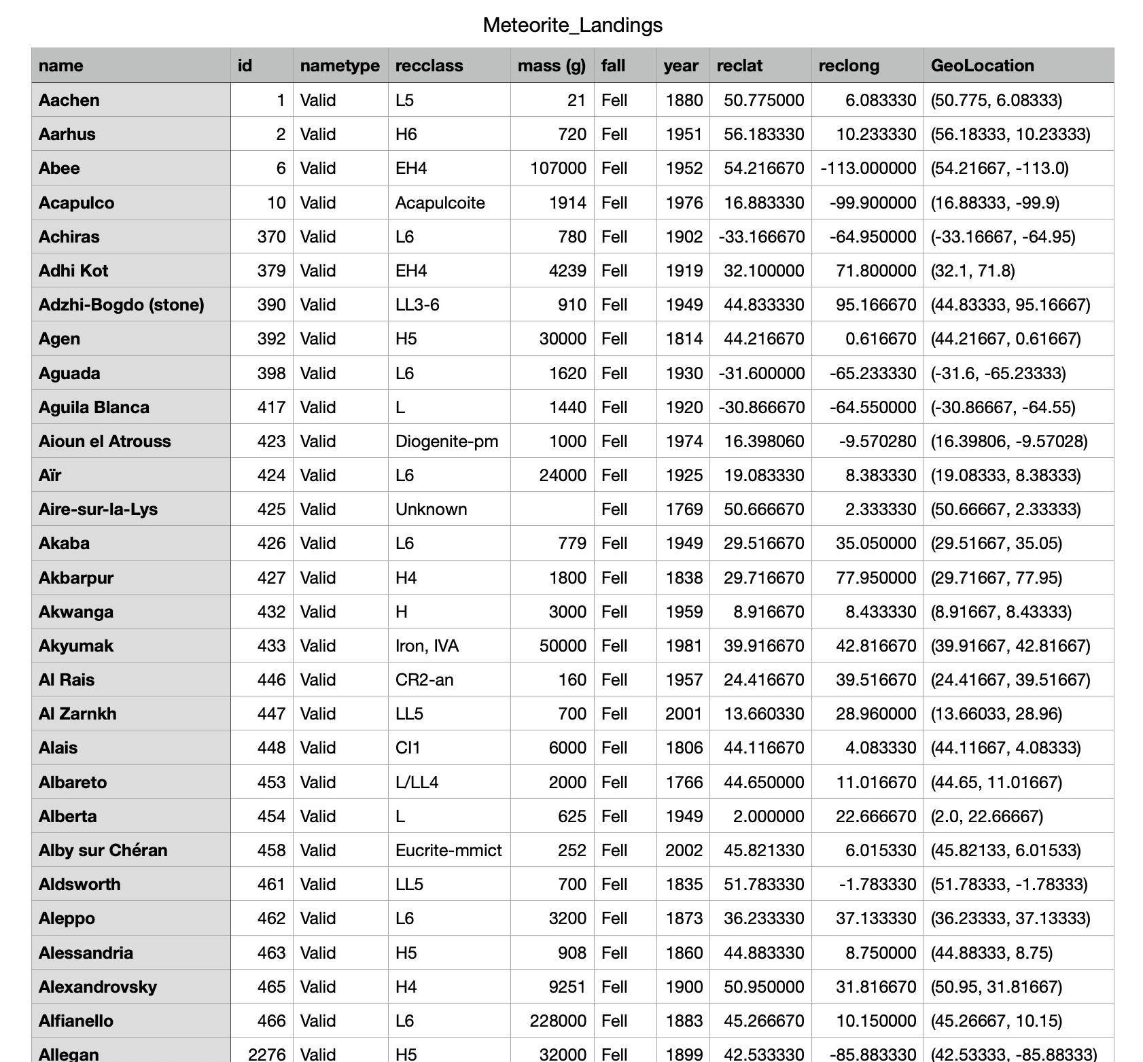

Slide 5
Variables
name: the name of the meteorite (typically a location, often modified with a number, year, composition, etc)
id: a unique identifier for the meteorite
nametype: one of:
valid: a typical meteorite
relict: a meteorite that has been highly degraded by weather on Earth
recclass (Classification): the class of the meteorite; Meteorites are classified according to a variety of characteristics, especially mineralogical, petrological, chemical, and isotopic properties.
mass: the mass of the meteorite, in grams
fall: whether the meteorite was seen falling, or was discovered after its impact; one of:
Fell: the meteorite's fall was observed
Found: the meteorite's fall was not observed
year: the year the meteorite fell, or the year it was found (depending on the value of fell)
reclat: the latitude of the meteorite's landing
reclong: the longitude of the meteorite's landing
GeoLocation: a parentheses-enclose, comma-separated tuple that combines reclat and reclong

Slide 6
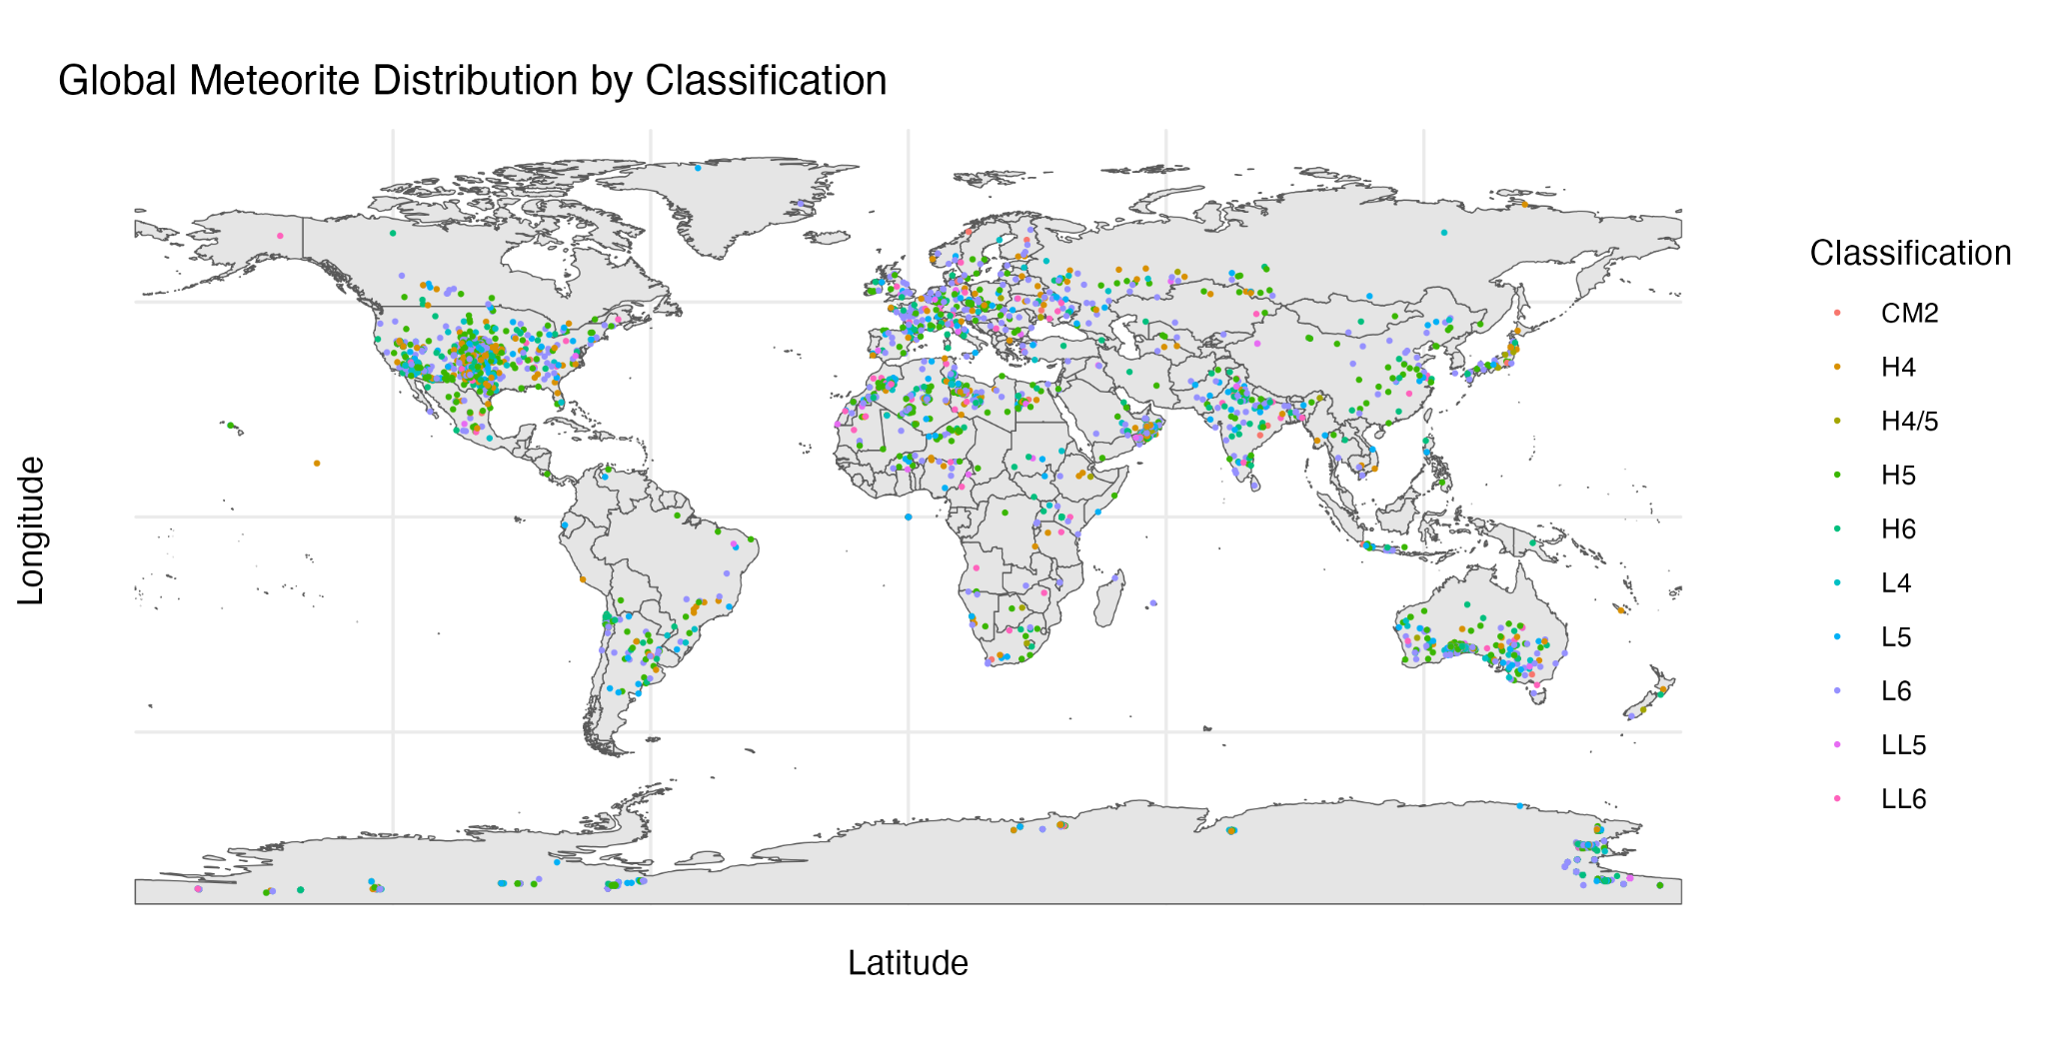

Slide 7
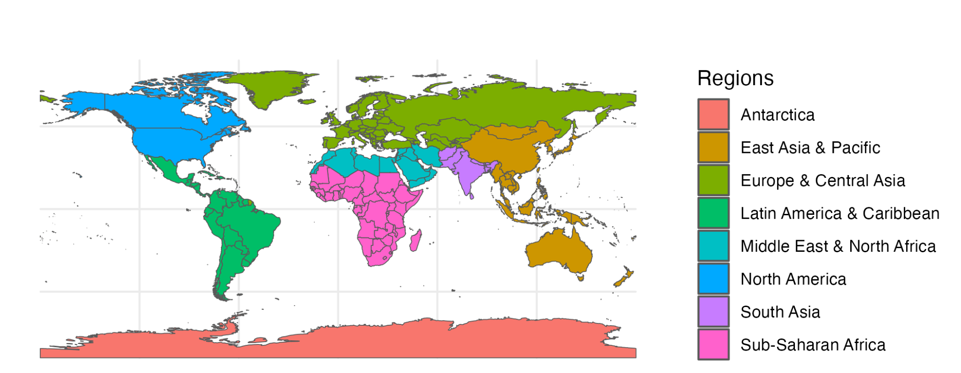
Global Meteorite Distribution by Classification - Descriptive Statistics
Region | Meteorite Count
Antarctica | 17381
East Asia and Pacific | 496
Europe and Central Asia | 321
Latin America and the Caribbean | 402
Middle East and North Africa | 3934
North America | 1101
South Asia | 111
Sub-Saharan Africa | 335
NA | 6371
Notes:
There is a mismatch between the sf tool and the data points -> the meteorites in antarctica are not shown on the map

Slide 8
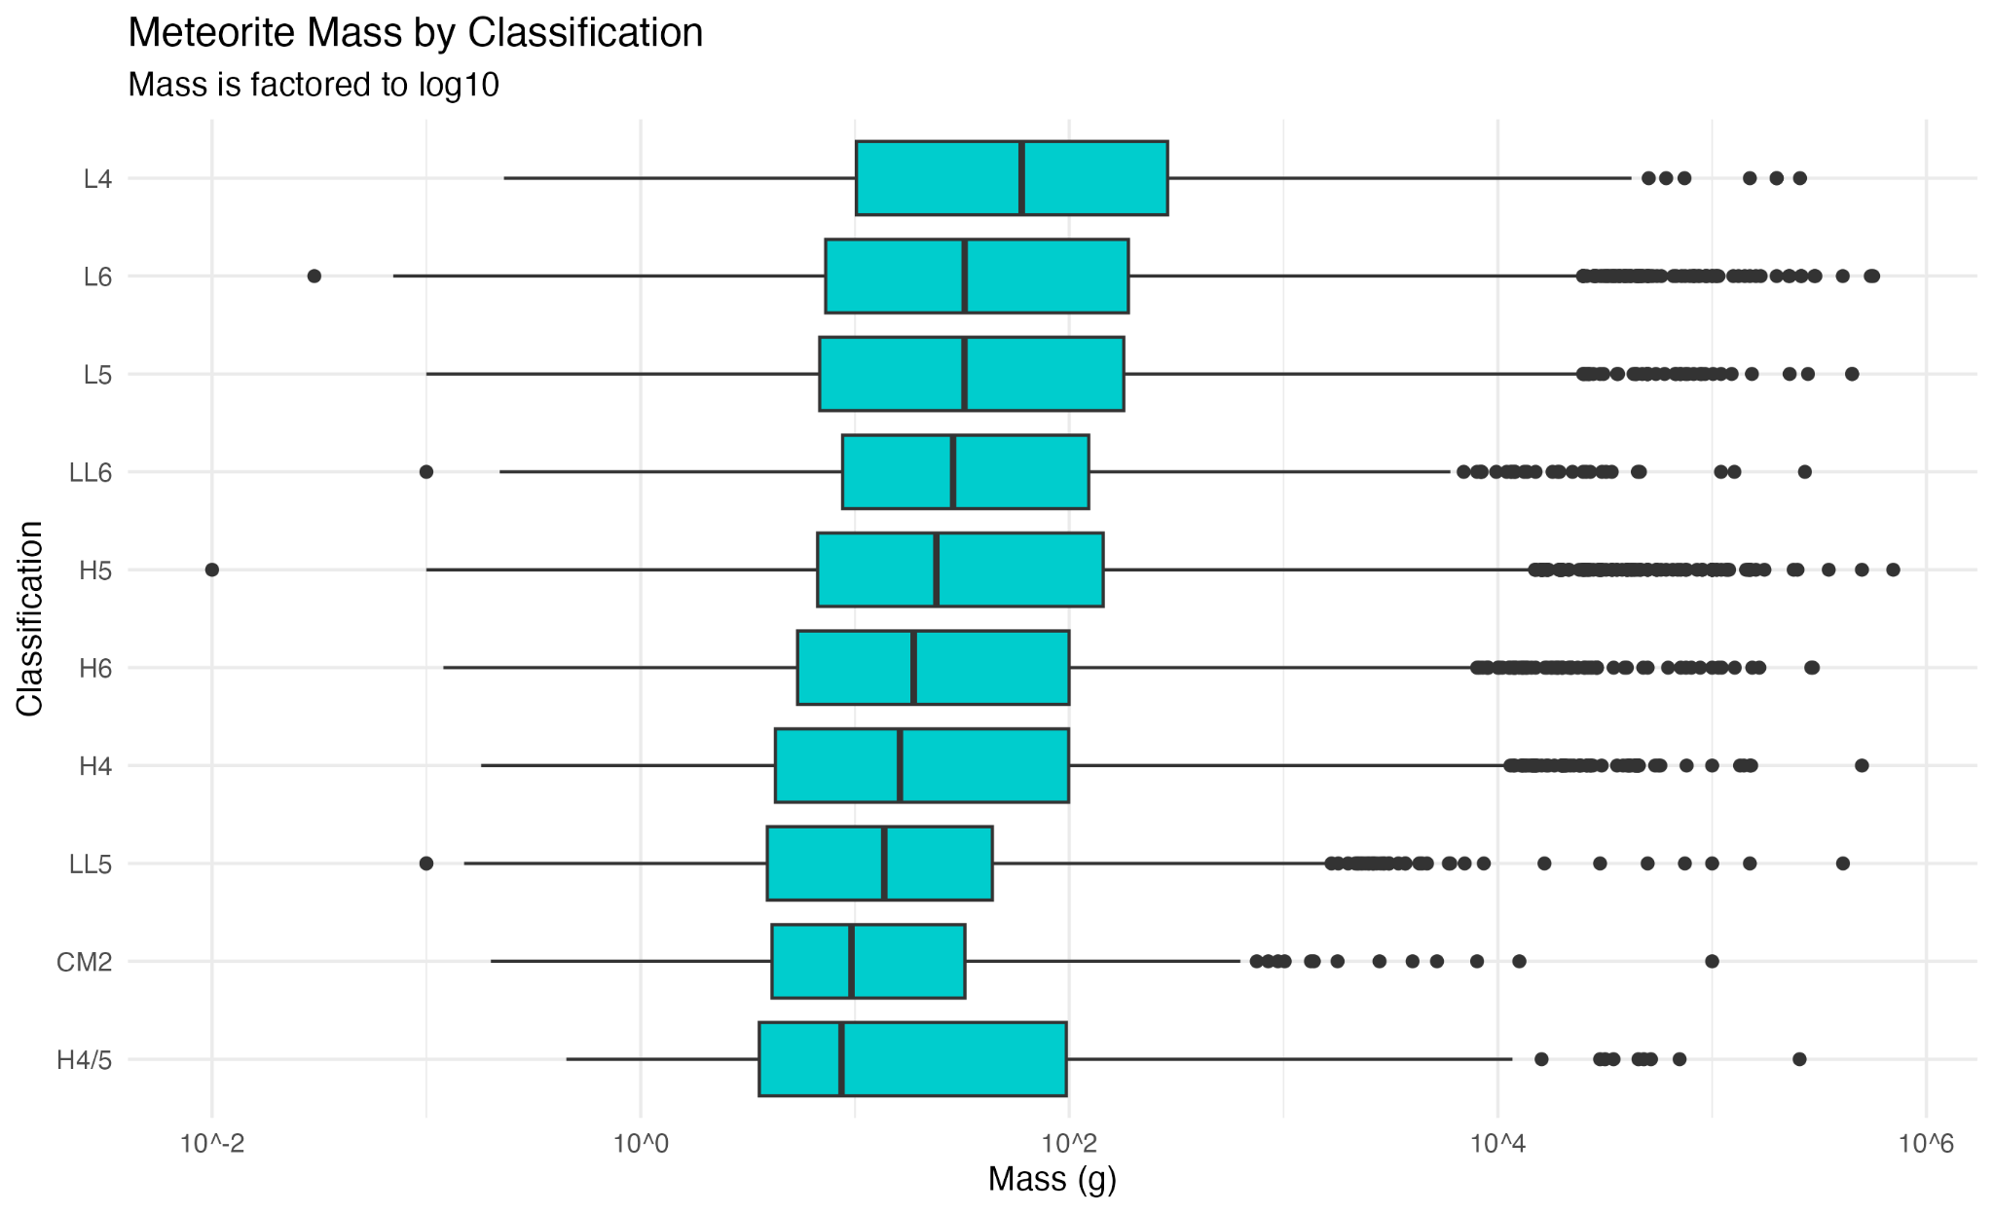
Data Visualization 2

Slide 9
Meteorite Mass (g) by Classification - Descriptive Statistics
Classification | Minimum | Median | Maximum
L4 | 0.23 | 60.00 | 257000
L6 | 0.03 | 32.50 | 564000
L5 | 0.10 | 32.50 | 1750000
LL6 | 0.10 | 28.70 | 271000
H5 | 0.01 | 24.00 | 4000000
H6 | 0.12 | 18.79 | 295000
H4 | 0.18 | 16.21 | 500000
LL5 | 0.10 | 13.70 | 408000
CM2 | 0.20 | 9.64 | 100000
H4/5 | 0.45 | 8.65 | 256000

Slide 10
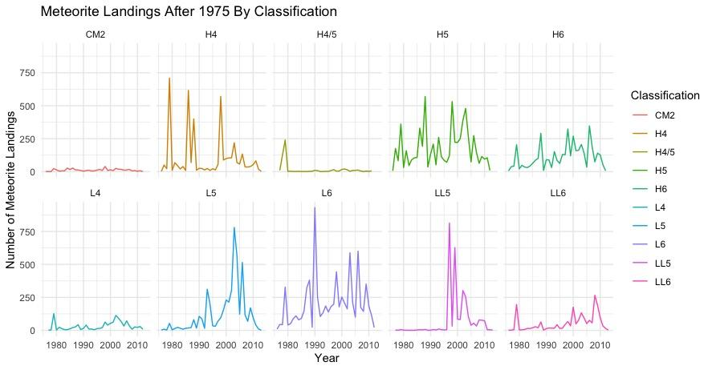
Data Visualization 1

Slide 11
# of Meteorite Landings per Year after 1975 by Classification - Descriptive Statistics
Classification | Minimum | Median | Maximum
L4 | 2.0 | 21.0 | 127.0
L6 | 10.0 | 168.5 | 930.0
L5 | 1.0 | 53.0 | 780.0
LL6 | 1.0 | 20.0 | 266.0
H5 | 6.0 | 118.0 | 569.0
H6 | 6.0 | 88.0 | 347.0
H4 | 2.0 | 39.0 | 709.0
LL5 | 1.0 | 6.0 | 813.0
CM2 | 1.0 | 9.0 | 39.0
H4/5 | 1.0 | 3.0 | 240.0

Slide 12
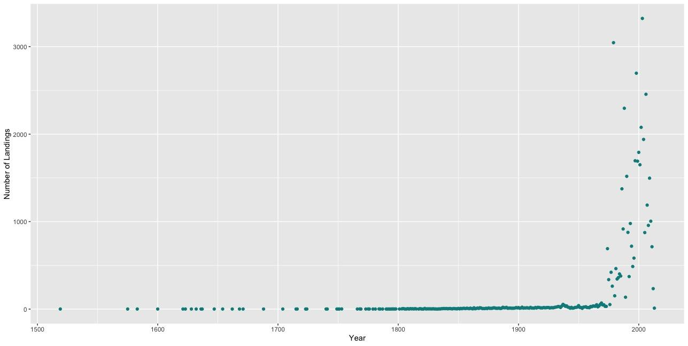
Number of Meteorite Landings by Year
Notes:
Median # of Landings: 10.5
Mean # of Landings: 176.0
Range of # of Landings: 1.0 to 3323.0
Range of Years: 1519 to 2013

Slide 13
Number of Meteorite Landings by Year - Descriptive Statistics
Number of Meteorite Landings per Year
Median # of Landings: 10.5
Mean # of Landings: 176.0
Range of # of Landings: 1.0 to 3323.0
Range of Years: 1519 to 2013

Slide 14
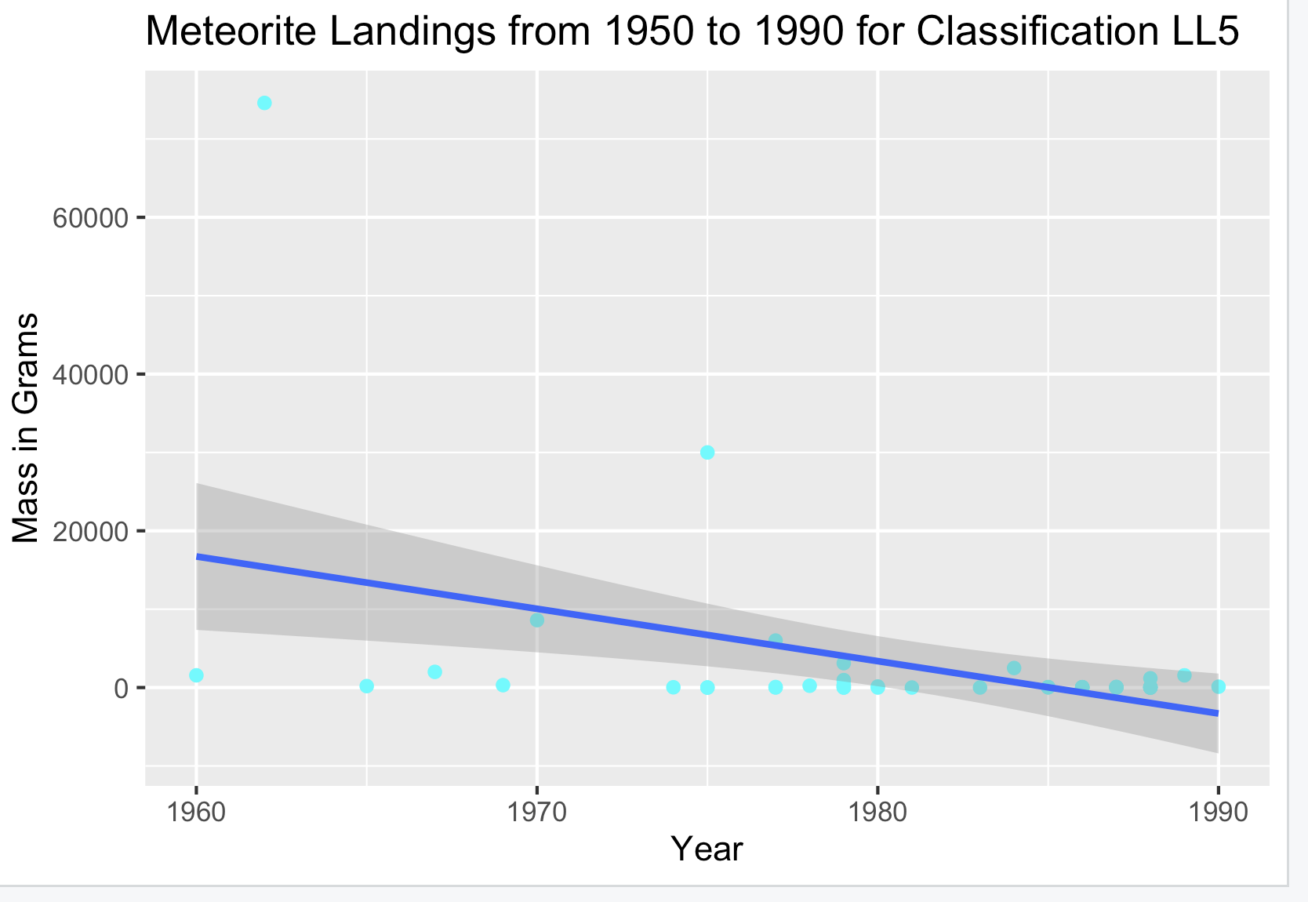
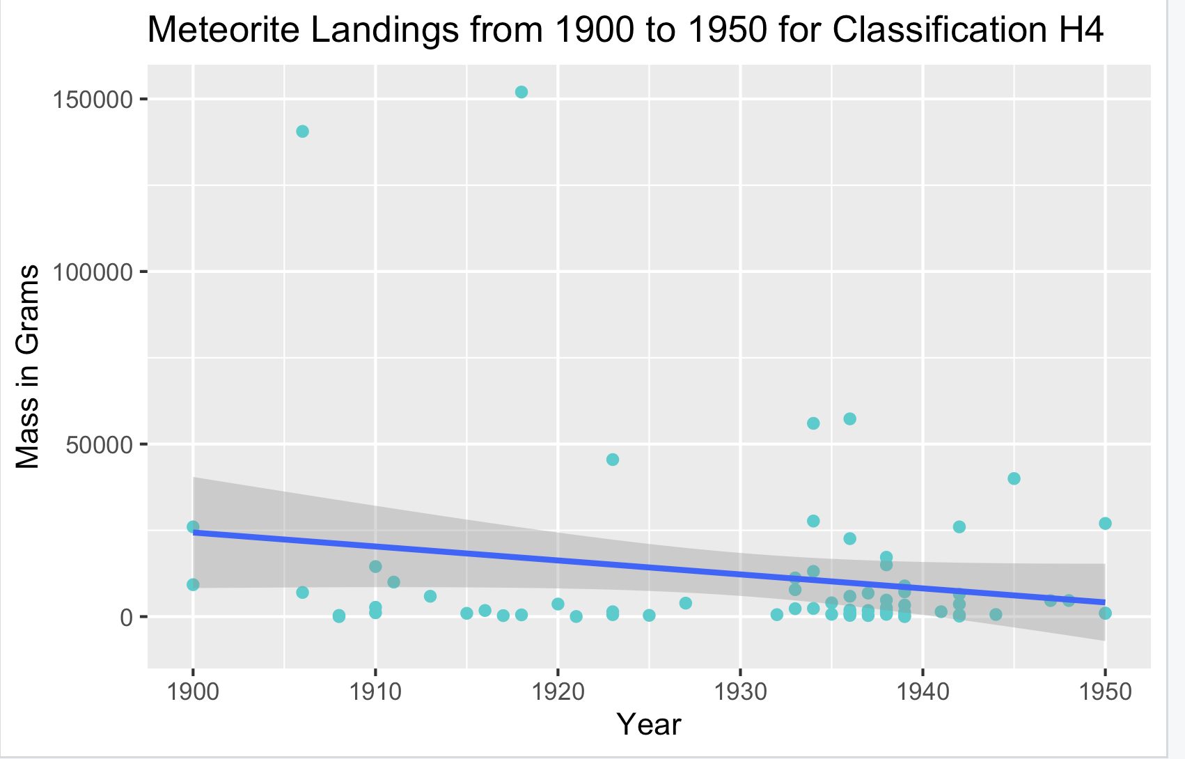
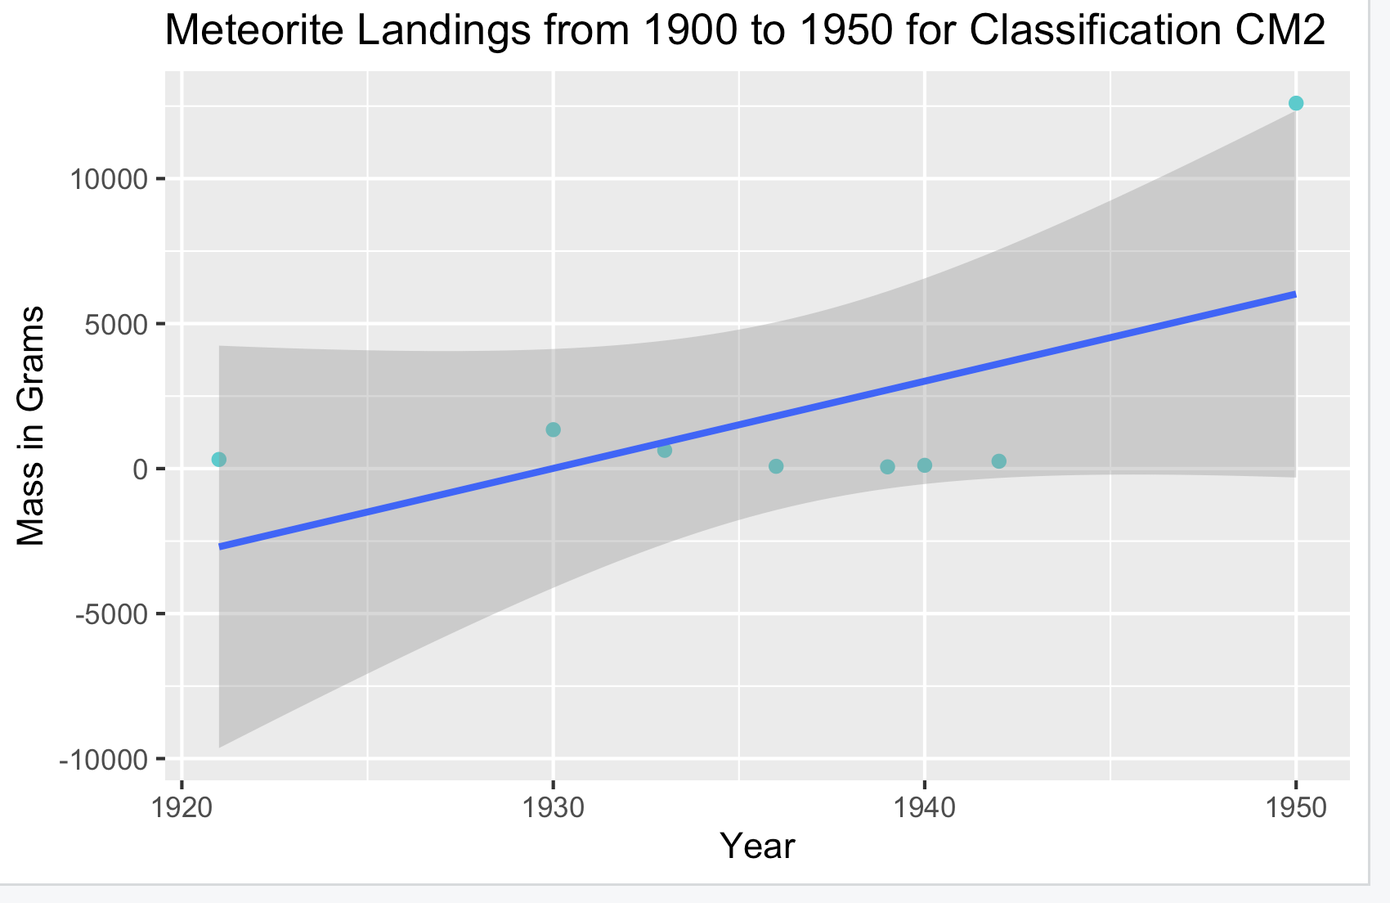
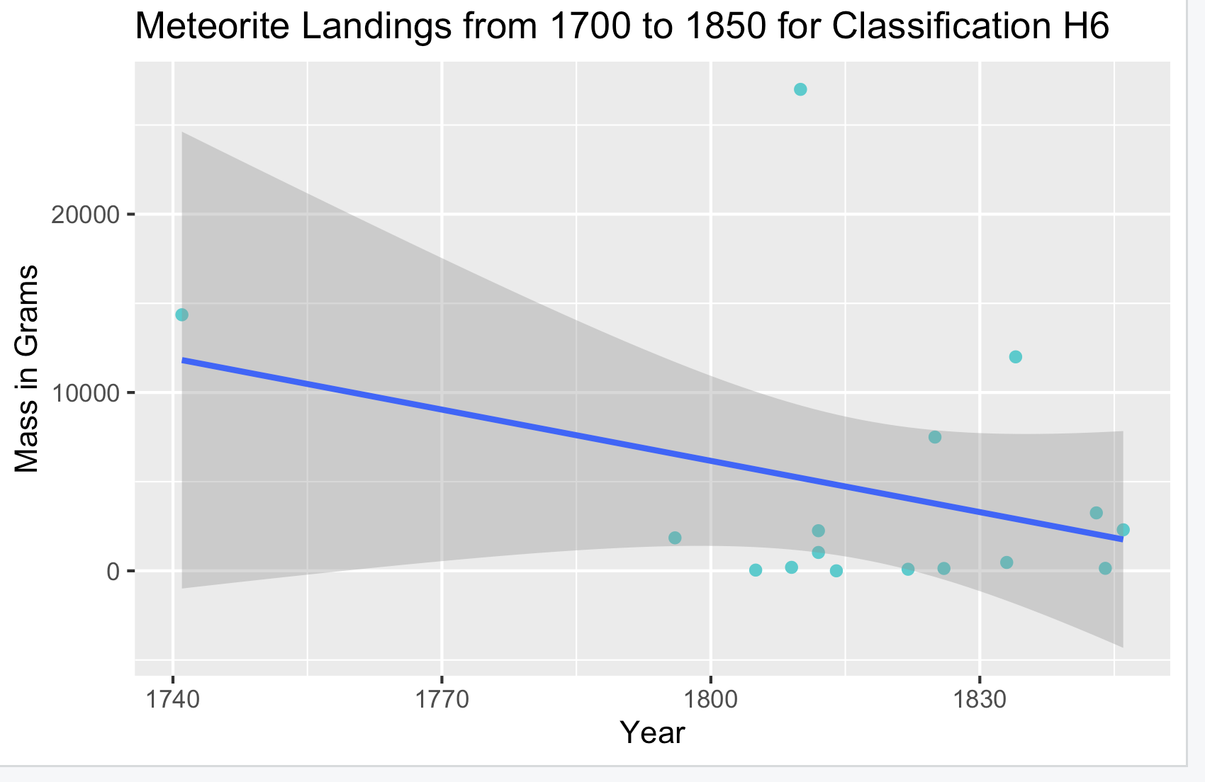
Linear Regression - Mass vs Year by Classification (Recclass)
Notes:
The Linear regression that we created was to see the correlation between the year, or time period of the meteorite, and the mass of the meteorites.
In order to make our analysis more specific, I used a vector with our primary ten classifications of meteorites, and then looped through them in order to get information about each classification and the meteorites masses for the specific time period.
Overall, we did not observe a clear indication of correlation between the mass and time period. However, as seen in the linear regression images above, there are some time periods in which weak correlations can be observed in particular classifications of meteorites.

Slide 15
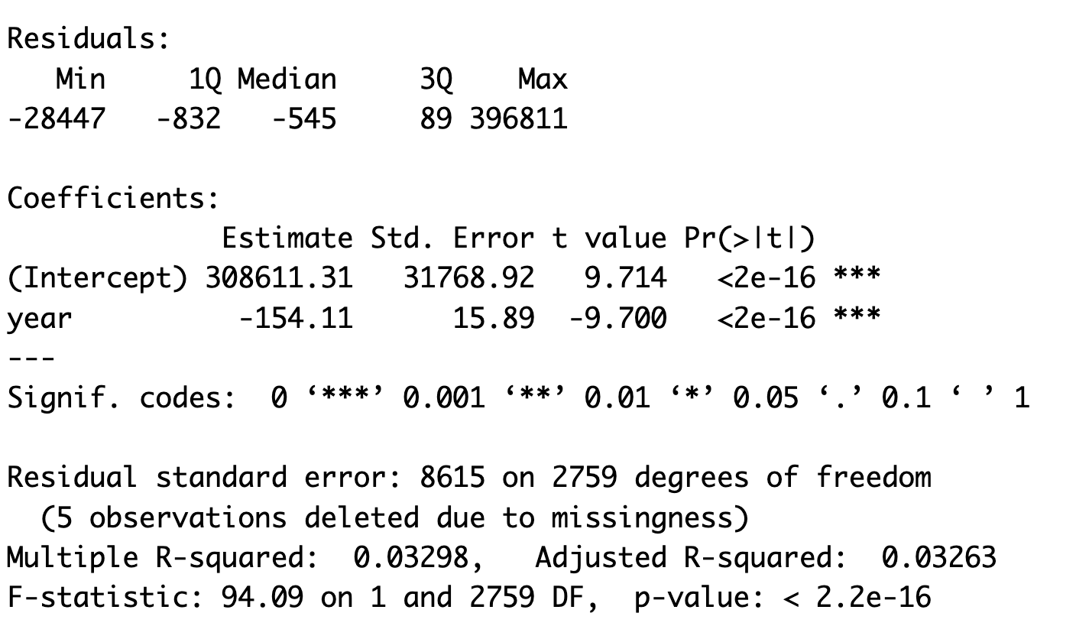
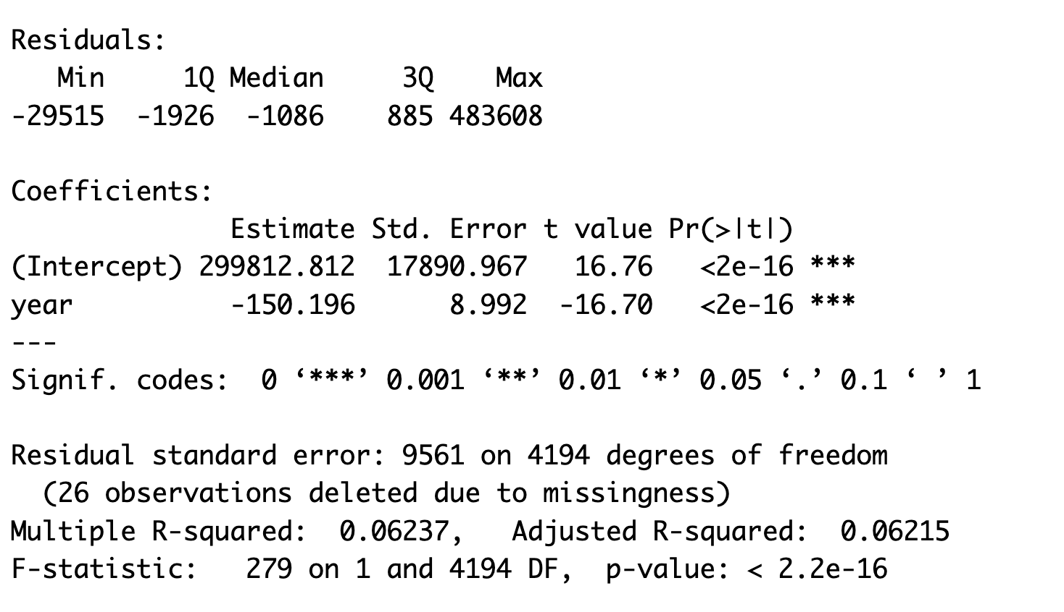
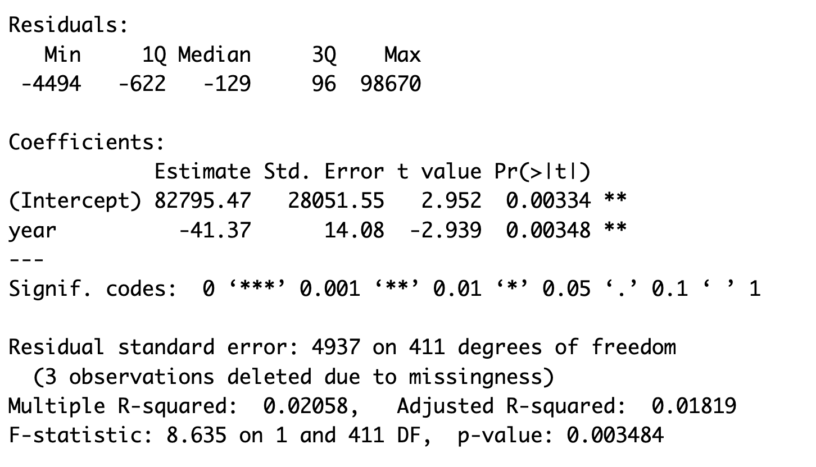
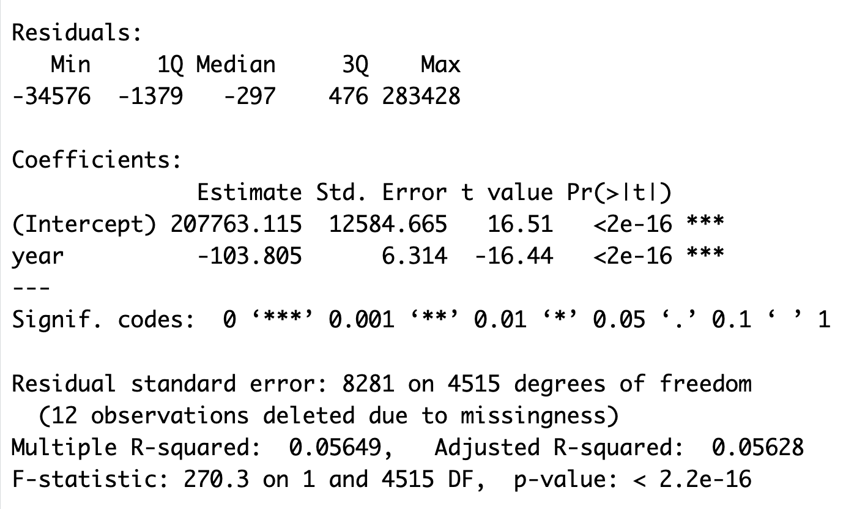
Mass vs Year by Classification - Descriptive Statistics
1950-1990 Class LL5:
1900-1950 Class H4:
1990-1950 Class CM2:
1700-1850 Class H6:
Notes:
Linear Regression Statistics for each of the four regression models that were presented in the previous slide.
As shown above in the statistics, the correlation remains weak in most cases of the regressions for our data, as it is not a clear correlation between the mass and the year or time period of the landing of the meteorites.

Slide 16
Conclusion
What were the main takeaways of the analysis?
One main takeaway from our analysis is that there have been an enormous number of meteorite landings. We had to narrow down our
dataset through a lot of filtering down, through narrowing down the classification, time period, and location.
Another interesting takeaway was how the median mass of the meteorite was surprisingly low, when we anticipated that we would
be dealing with very large masses. This indicates they included meteorites of all sizes, not just the enormous ones people imagine when
thinking about meteorites.
What are the limitations of the analysis (including the data collection scheme)?
One limitation is that there was no information about the data collection process on data.gov, NASA, or Kaggle. The lack of this
information may prevent us from accounting for potential bias in our analysis
Another limitation of the data analysis is that in our World Map, most of the meteorite landing locations are in areas that are
inhabited by humans. This is both due to the mismatch between SF and our dataset and presumably because meteorites are more likely to be
found and observed in places with more people. Therefore, the locations of the landings may be skewed in a way that suggests meteorites are
more likely to fall in inhabited areas.
Another limitation is that older meteorite recordings may not be as accurate as more recent ones. More meteorite landings were
recorded in specific time periods compared to others, which may have been due to greater technology.
Finally, there were many incomplete or missing geolocations. In order to create the map we had to remove these data points, making it
impossible to depict all of the meteorite landings that were included in the dataset.
Future steps/analyses of interest?
It would be interesting to develop a more complete meteorite dataset. We would like to have the geolocation of all meteorites to depict a complete map.
Another analyses of interest would be verifying the validity of past meteorite landings. While there have been many recordings of meteorite landings in the past, we know that many of these may not be accurate, particularly the specific recclass types, mass, and geographic location.
Notes:
Takeaways
Big number of meteorite landings
Median mass was low
Limitations
No info on data collection process
Human inhabited bias
Older meteorite landings inaccurate
Incomplete geolocations
Future Steps
More complete dataset with filled out geolocations
Verifying validity of past meteorite landings

